Slide 1
NAS Architecture as SoS
Tracing Operational Intent from Enterprise Objectives to Aircraft Trajectory
Owen M. O’Keefe

Slide 2
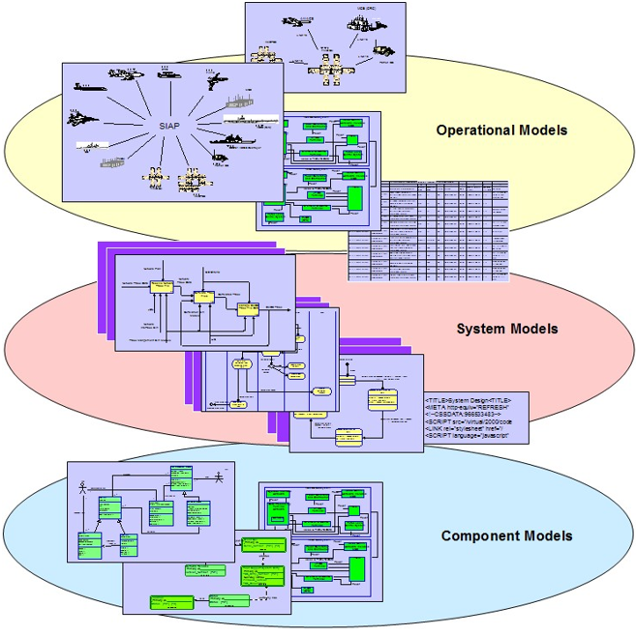
Project Overview
Build a reference MBSE architecture for how airspace intent is managed across the National Airspace System (NAS).
Investigate how information accuracy impacts stakeholder tradeoffs under disruption and recovery events
Two Claims:
  Higher fidelity = Higher Optimality
  MBSE can identify the issue
2

Slide 3
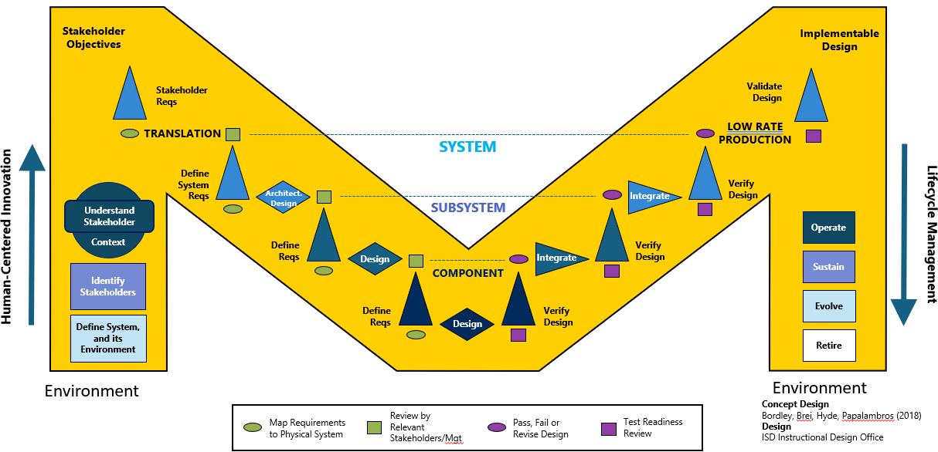
Methodology
Model Based Systems Engineering – use SysMLv2 within VS Code to create complete validation of conflict resolution.
Model Scope:
  Organizations that define and enforce rules,
  Domains that manage airspace resources,
  Systems that support flight operations, and
  Onboard systems that turn intent into behavior.

Slide 4
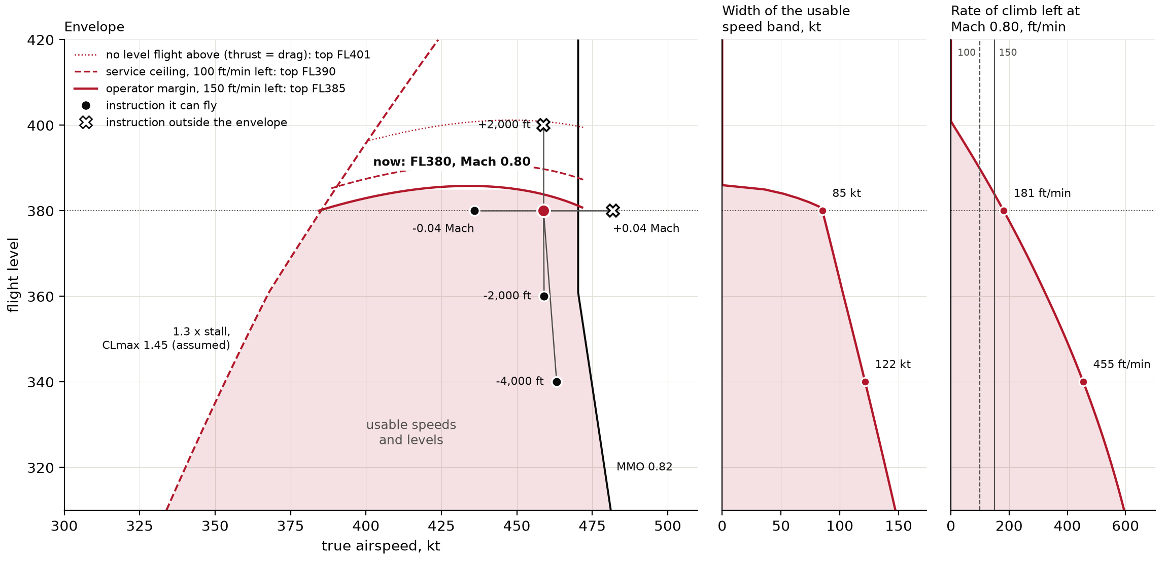
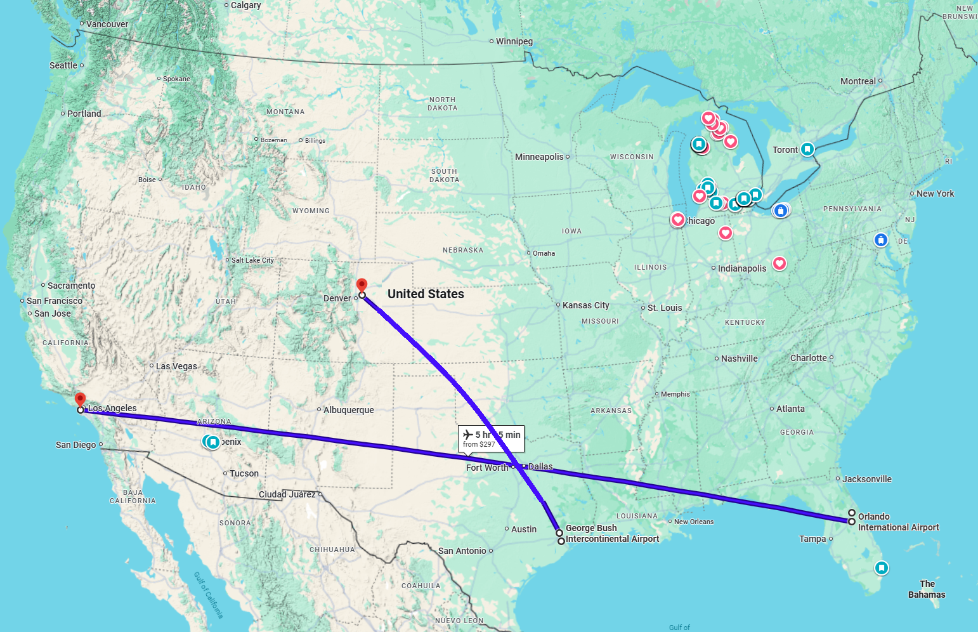
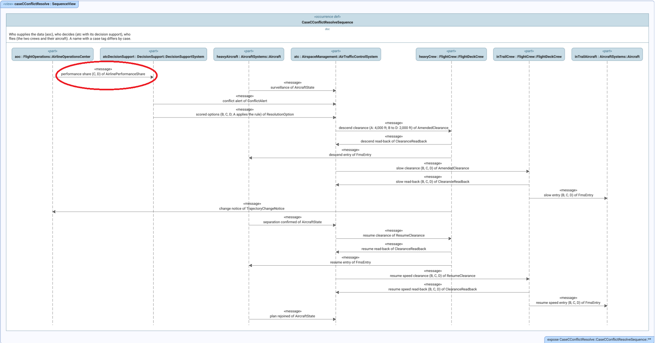
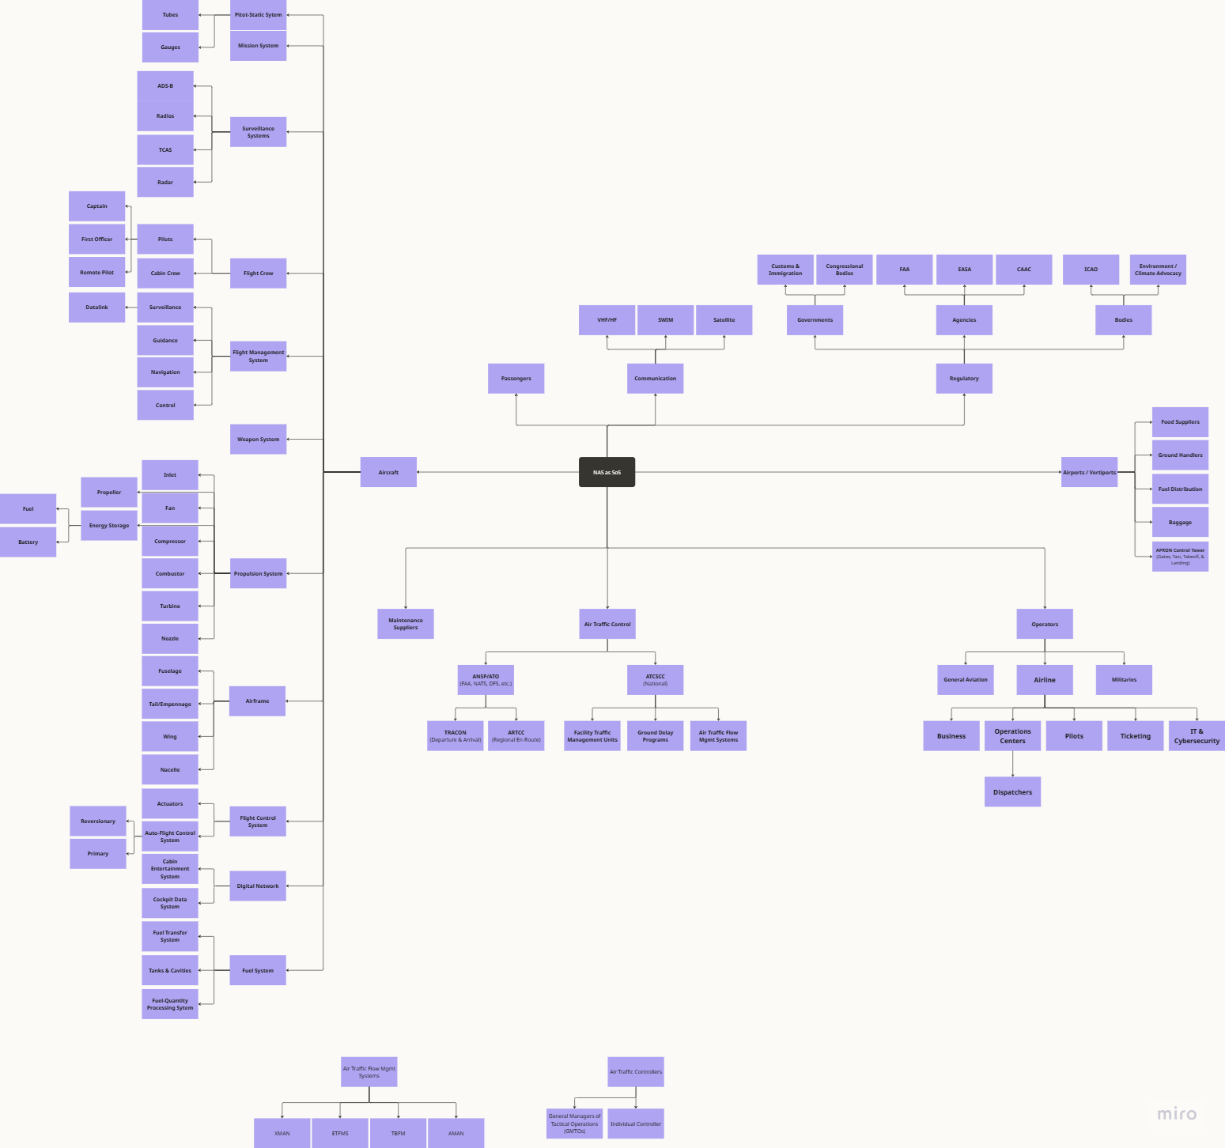
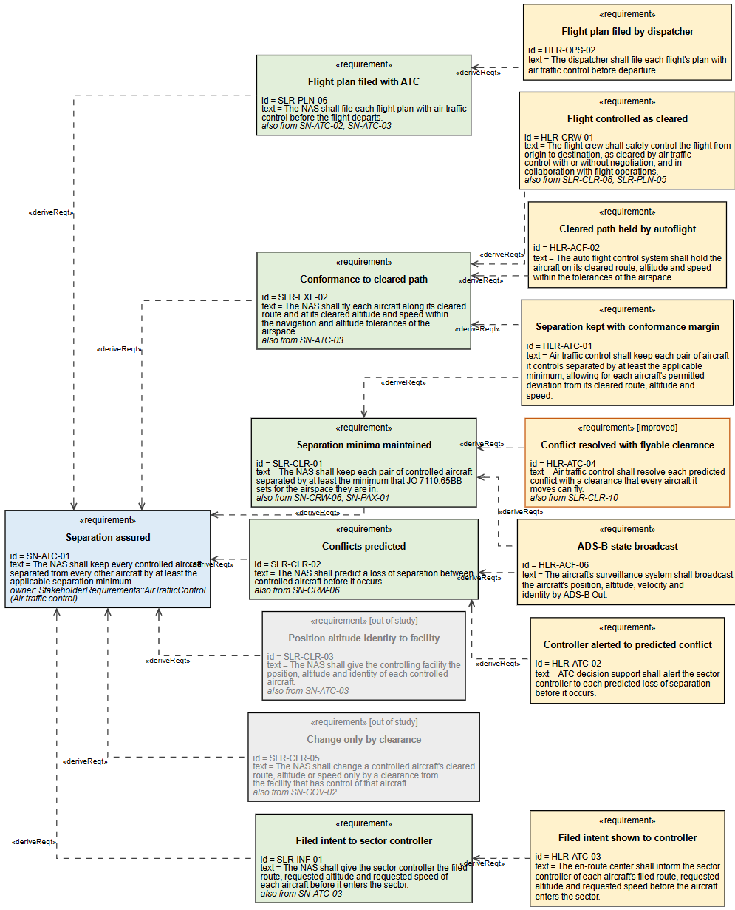
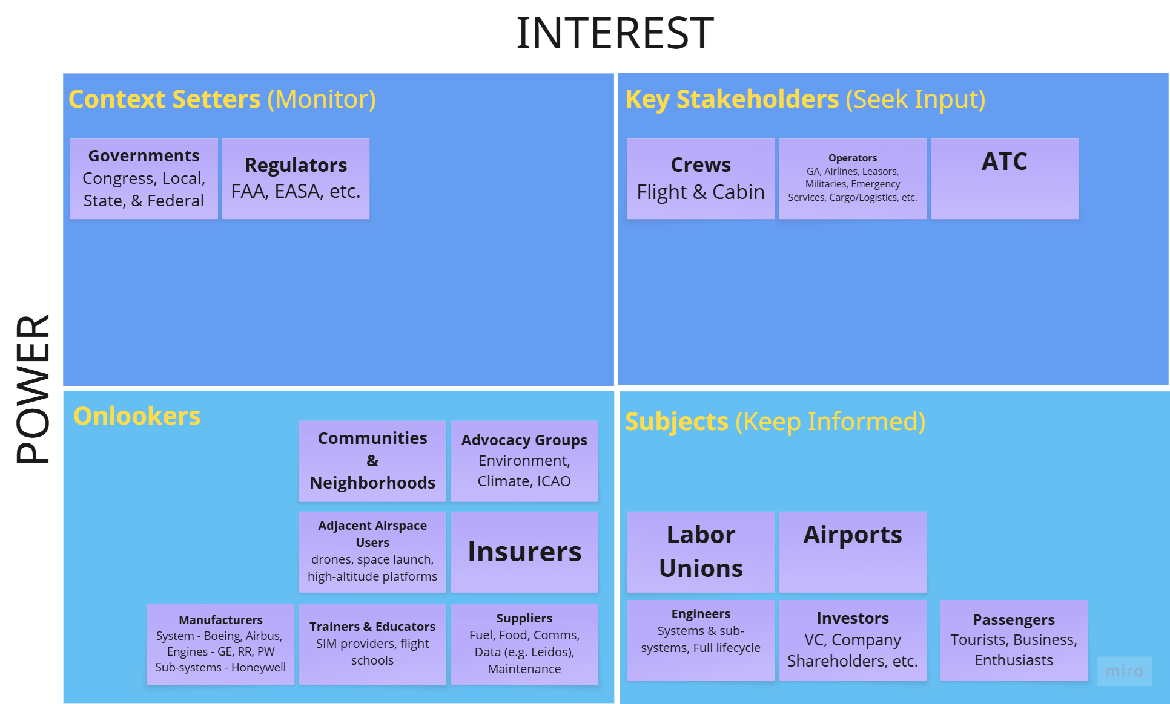
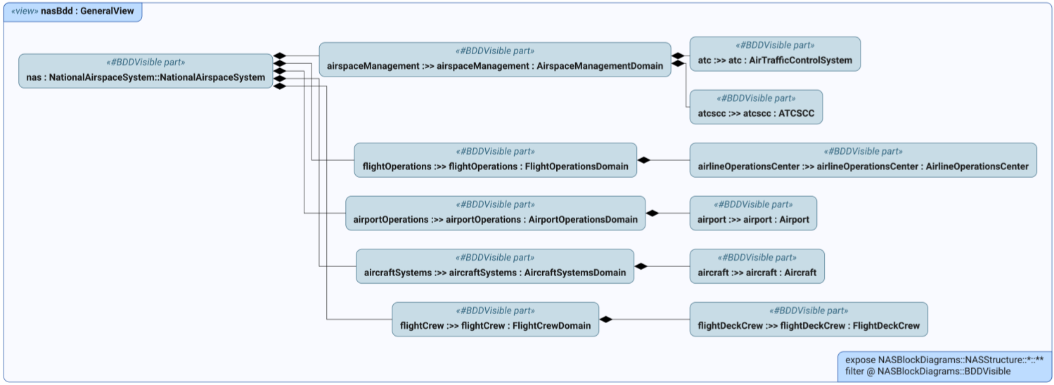
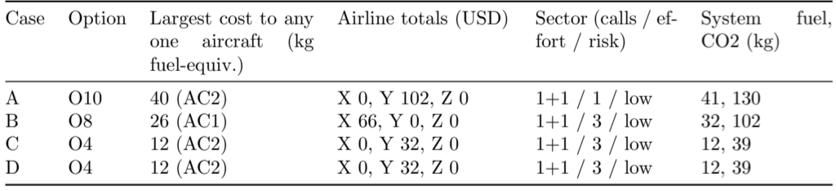
Preliminary Results
Stakeholders & their objectives identified
Constituent systems determined
SLRs through HLRs developed
Models of all systems created
Information gap identified
2 Alternative Approaches Tested

Slide 5
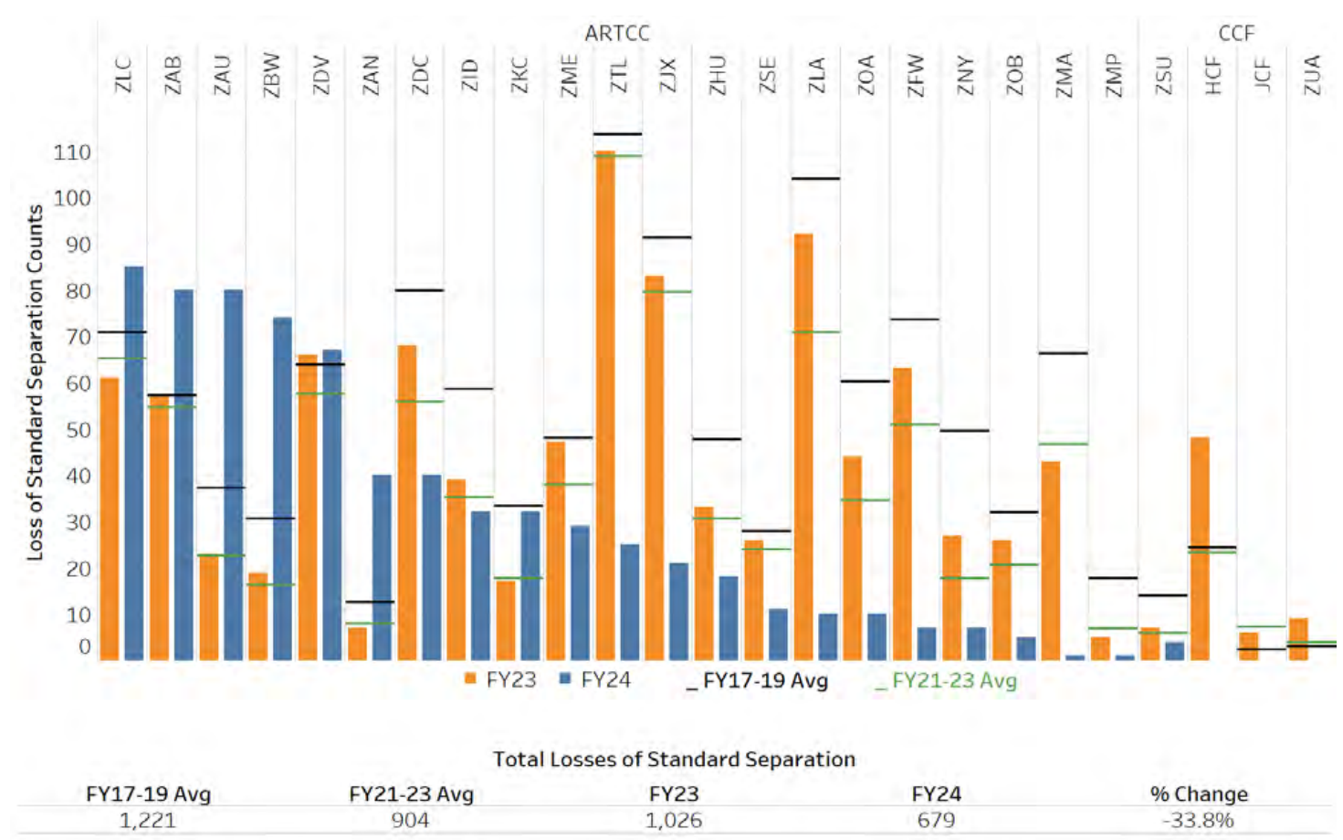
Project Benefits - Example
Increased Per-Conflict Efficiency:
  70% reduction per-aircraft cost, ensuring pilot performance isn’t negatively impacted
70% reduction per-airline cost
70% reduction in overall system fuel expenditure and emissions
Additional Considerations:
  Increases controller workload
  Requires airlines to provide ship-specific data
100s of separation losses per year, despite ATC interventions

Slide 6
Thank you!
Forever, Go Blue!

Slide 8
Optimizing Workflow and Efficiency in General Assembly
EXAMPLE
Student Name

Slide 9

Project Overview - Example
Enhance efficiency of the General Assembly lines
  Maximize productivity
  Ensure seamless operations
  Improve throughput
  Improve customer satisfaction
Currently assembly line design is
creating uneven workload distribution
  Target rebalancing of workstations to reduce cycle times and align to takt time of 240 seconds
Internal stakeholders: management, line workers, process engineers, operations engineers
External stakeholders: customers and shareholders/investors
9

Slide 10
Project Scope and Deliverables - Example
Scope
  Rebalancing of all workstations within the General Assembly lines
Deliverables
  Balanced Line Layout Proposal
  Validated Trial Plan for Implementation
  Comprehensive Project Report

Slide 11
Methodology - Example
Define
Measure
Analyze
Improve
Control
Video Recording Time Studies
MODAPTS Time Studies
YAMAZUMI Rebalancing Charts
Pilot Trials for Improvement

Slide 12
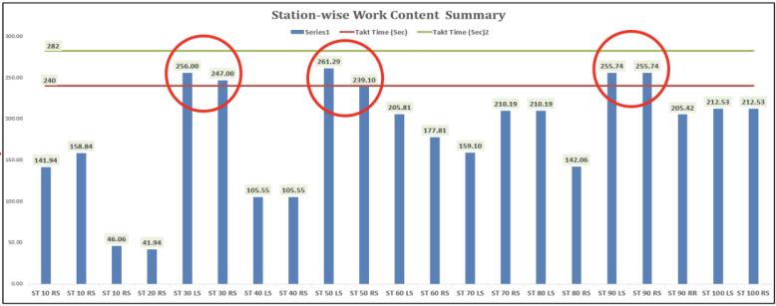
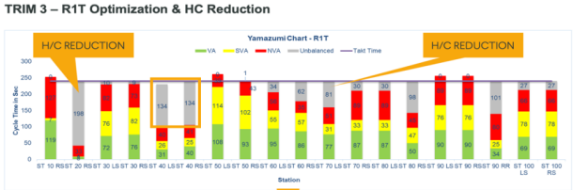
Preliminary Results - Example
Trim 3 General Assembly Rebalance
  Shift operations from 40LS to 30LS
  Reallocate operations at 70LS
  Shift operation from 90RF to 80RS
Trim 3 Headcount Reduction
  $200,000 cost savings

Slide 13
Project Benefits - Example
Increased Efficiency
  Reduced bottlenecks and delays
  30LS cycle time reduction of 23%
  40LS cycle time reduction of 19%
Headcount Reduction Cost Savings: $200,000
Other Benefits
  Improved throughput
    Ability to meet production demands by adjusting process time to takt
  Streamlined Material Flow
  Enhanced Customer Satisfaction
  Investor Confidence

